Slide 1



Discuss about quality of product by way of example “Dodge Challenger”
Prepared: Podstrechnyy A.V.
Checked: Gonchar A.E.

Slide 2
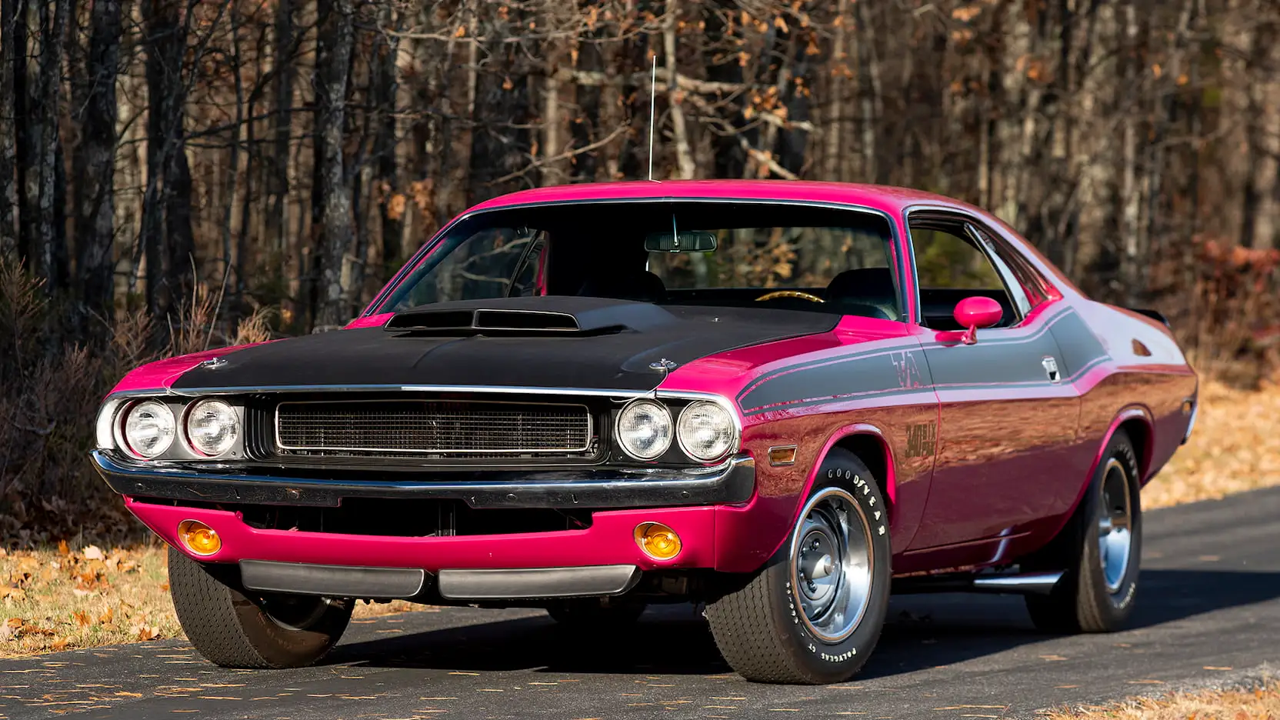
Content
Theory about product’s quality;
History of the brand;
History of the Dodge Challenger;
Advantages and disadvantages;
Suggestions for improvement;
Conclusion;

Slide 3
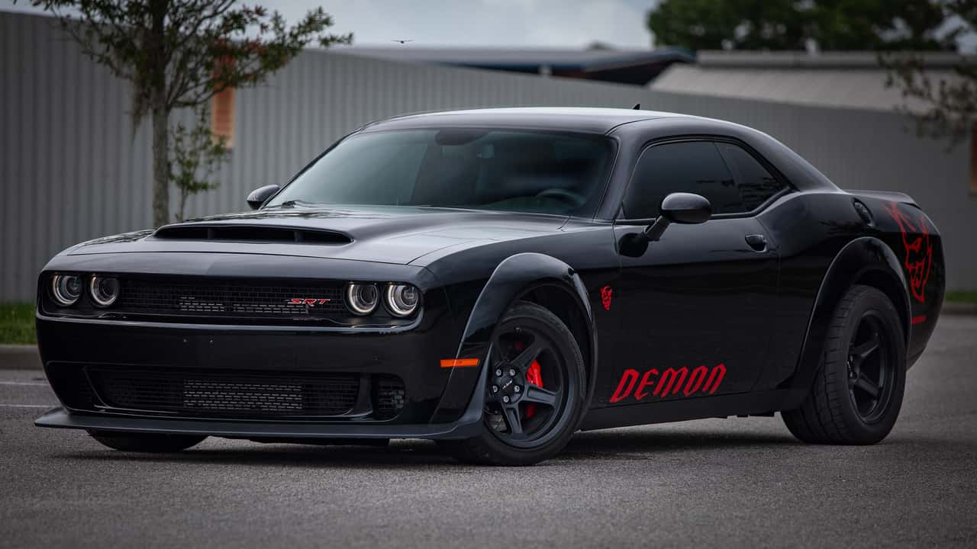
Components
Specifications and standards;
Customer satisfaction;
Absence of defects and errors;
Reliability and Durability;
Innovation and improvement;
Ethical and environmental aspects
Theory
Quality - is conformance to specification when components and the product as a whole are manufactured exactly as designed.

Slide 4
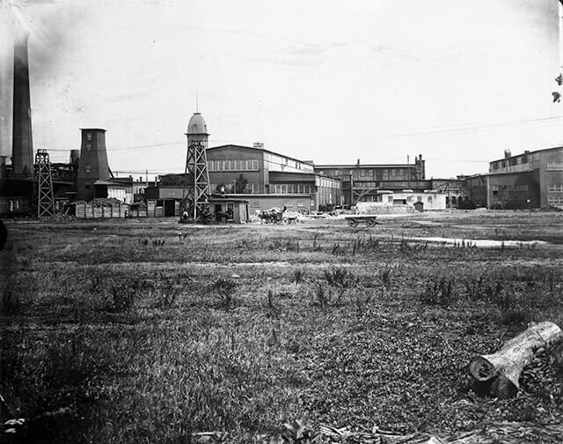
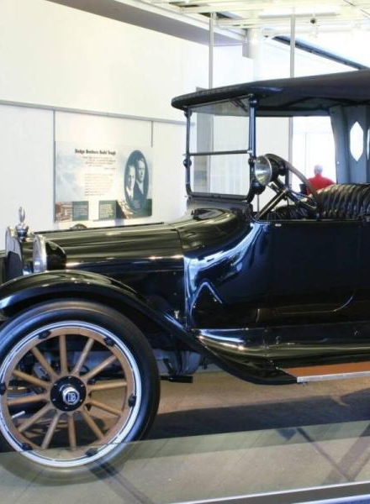
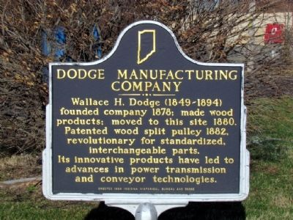
History of the company
Founded as the Dodge Brothers Company machine shop by brothers Horace Elgin Dodge and John Francis Dodge in the early 1900s, Dodge was originally a supplier of parts and assemblies to Detroit-based automakers like Ford.

Slide 5
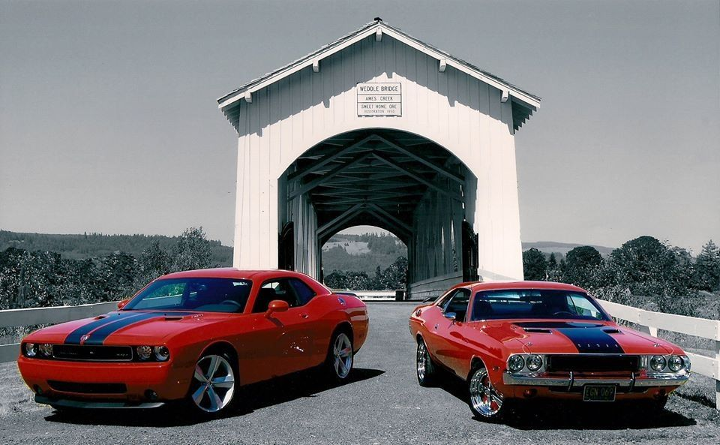
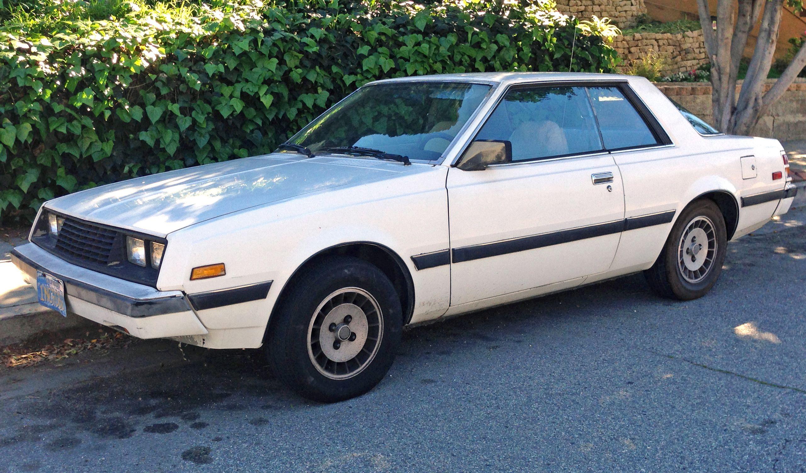
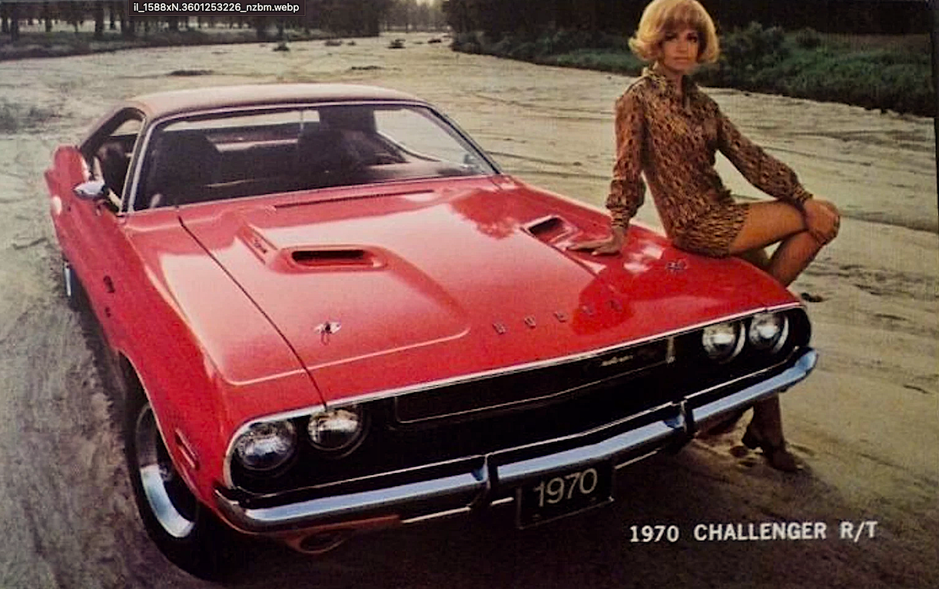
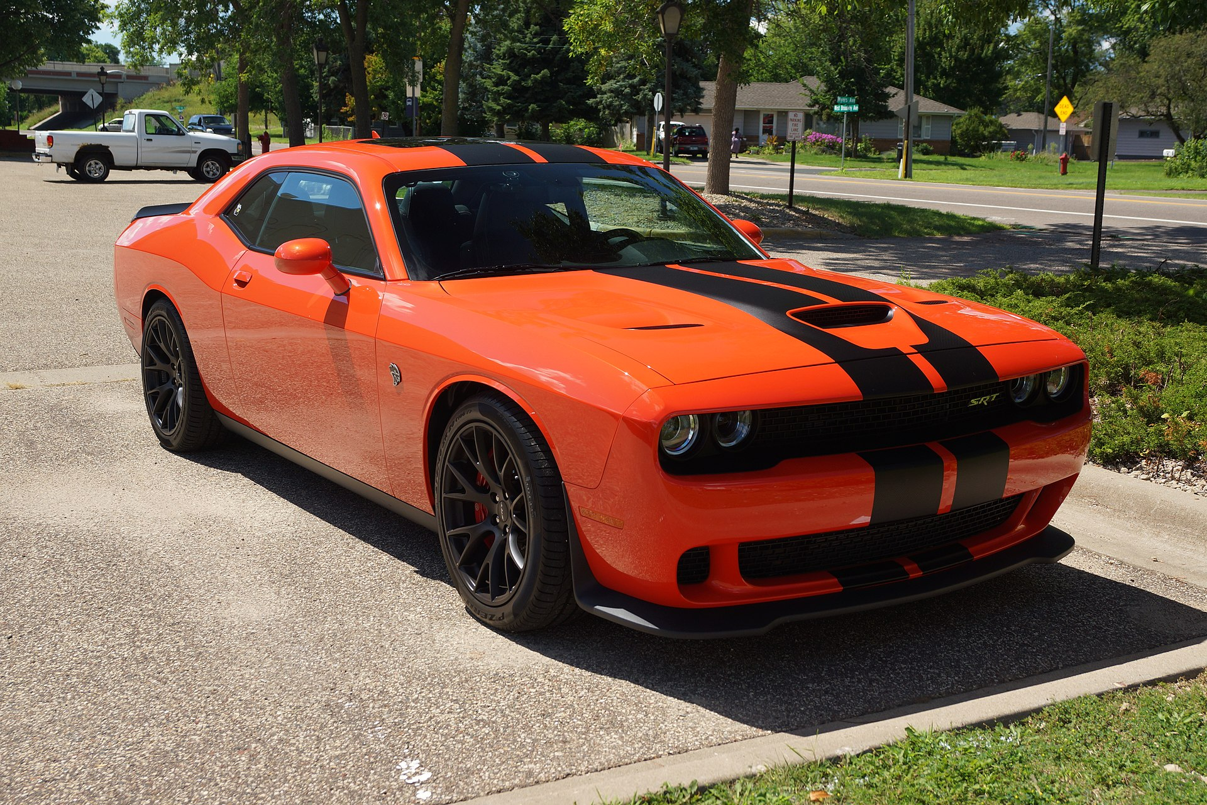
History of the product
Brand: Dodge
Model: Challenger
Production: 1969 - present

Slide 6
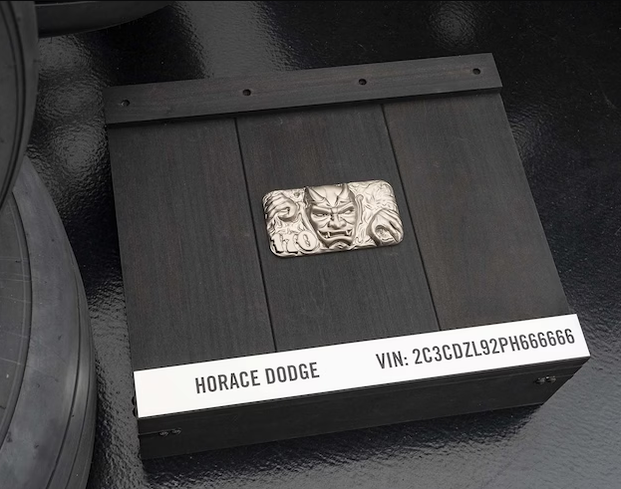
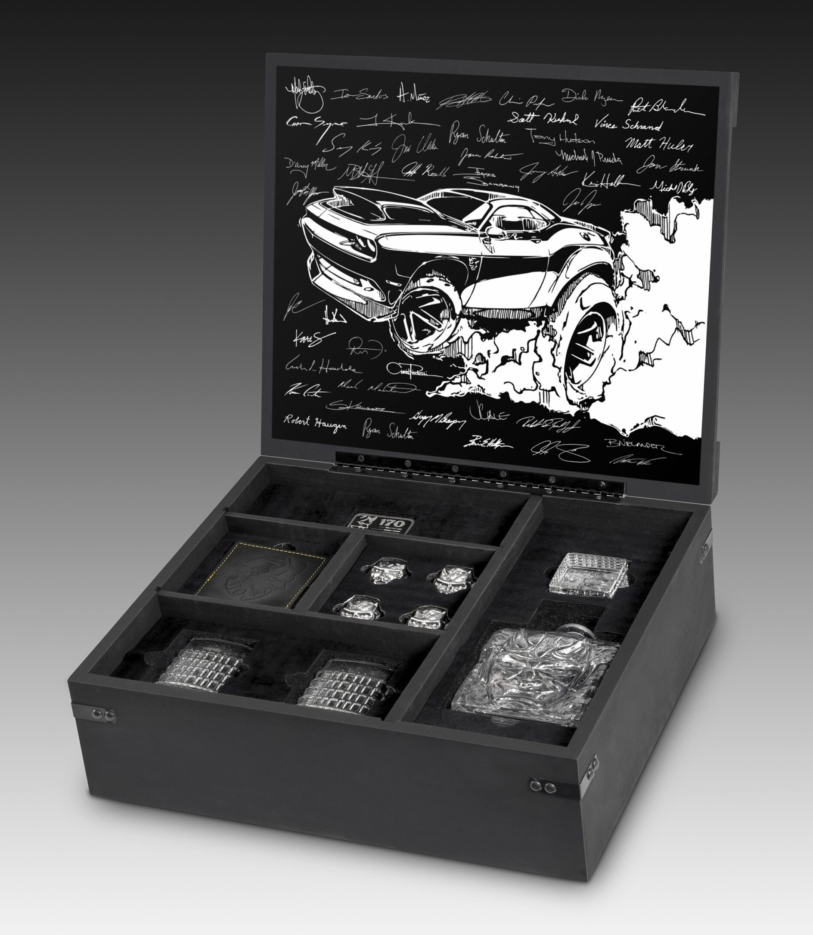
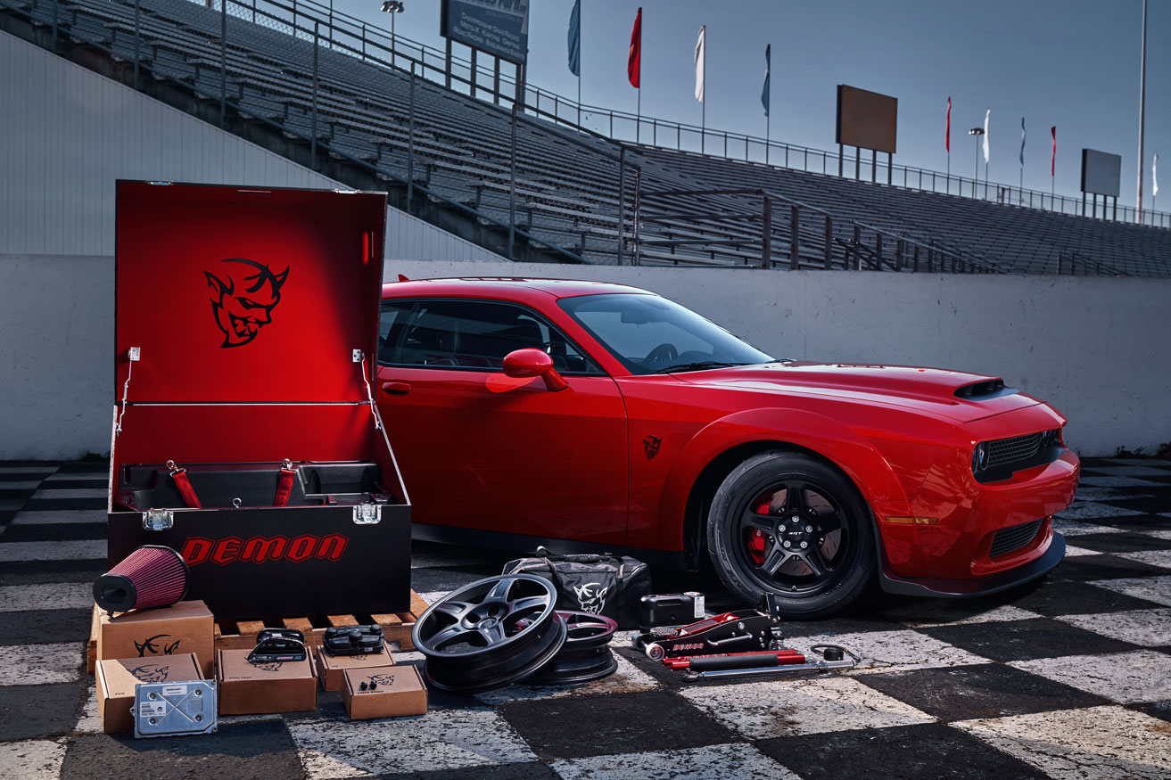
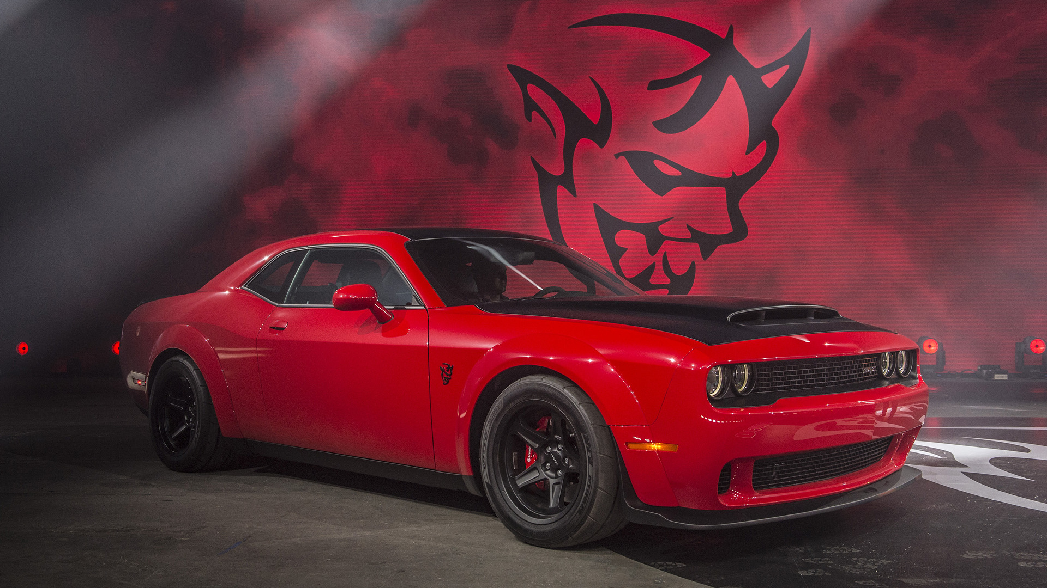
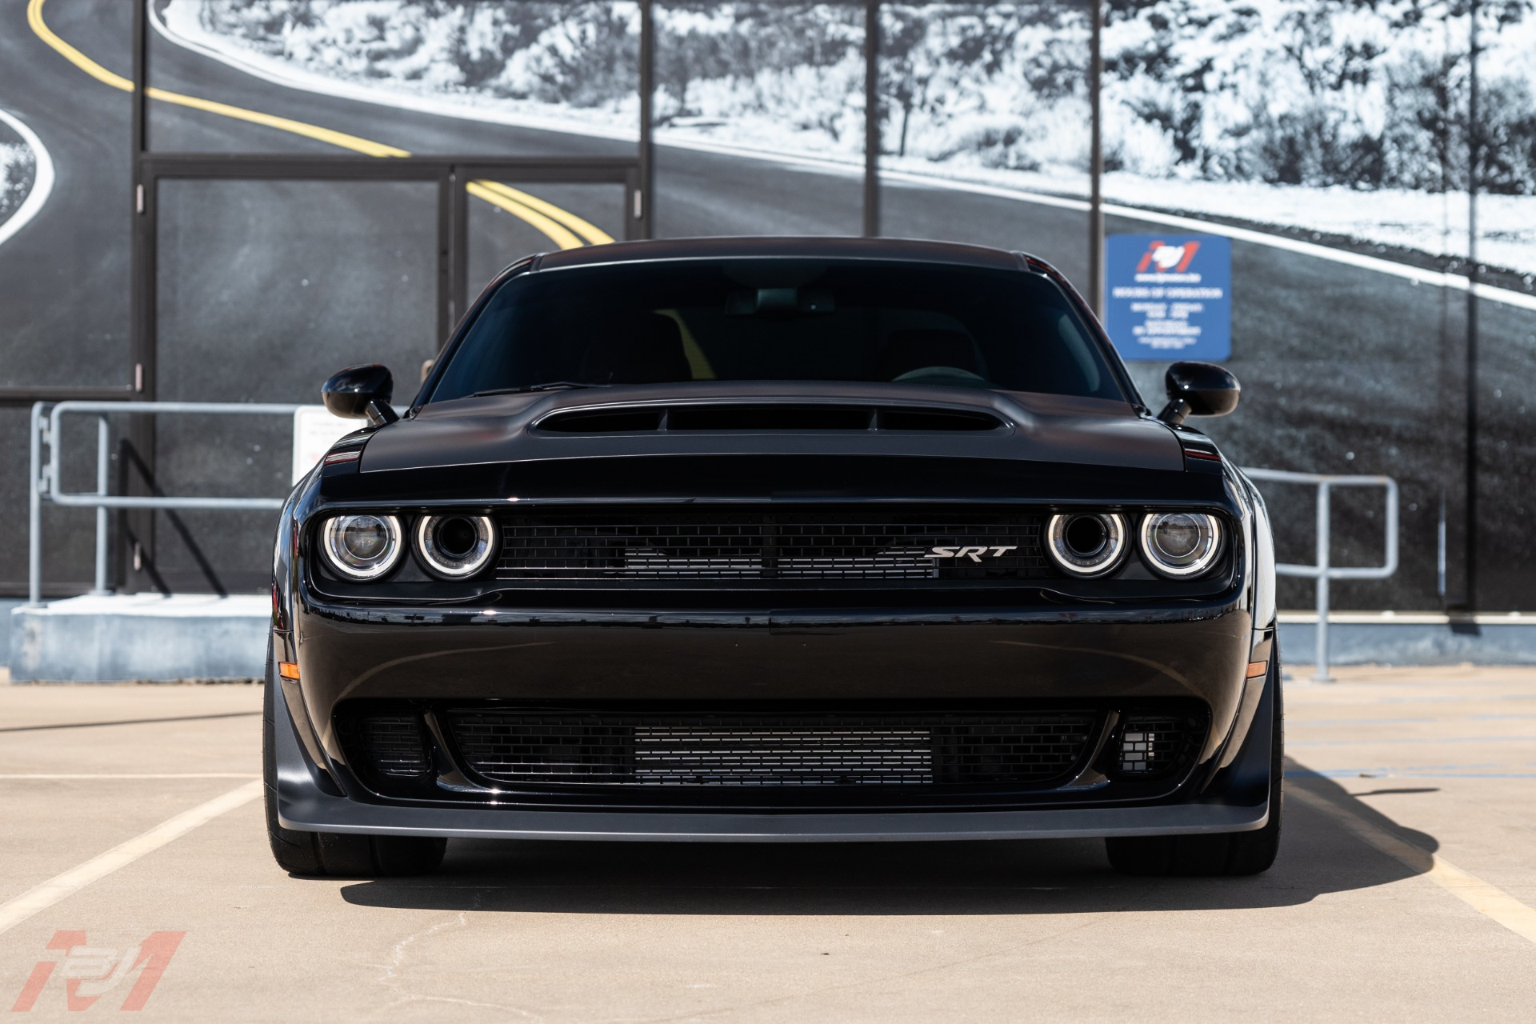
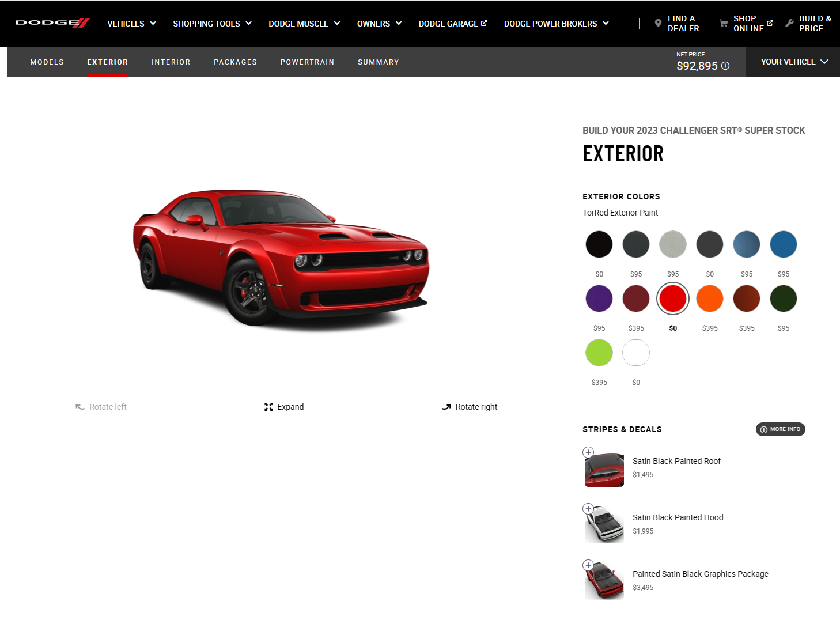
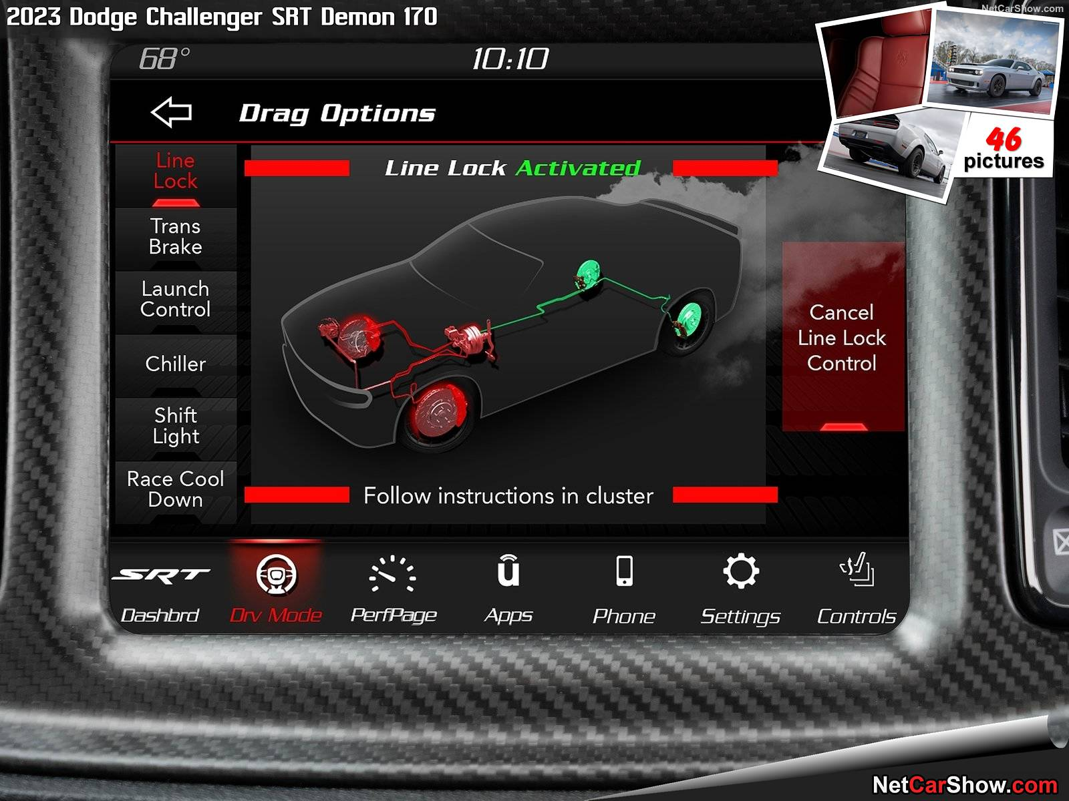
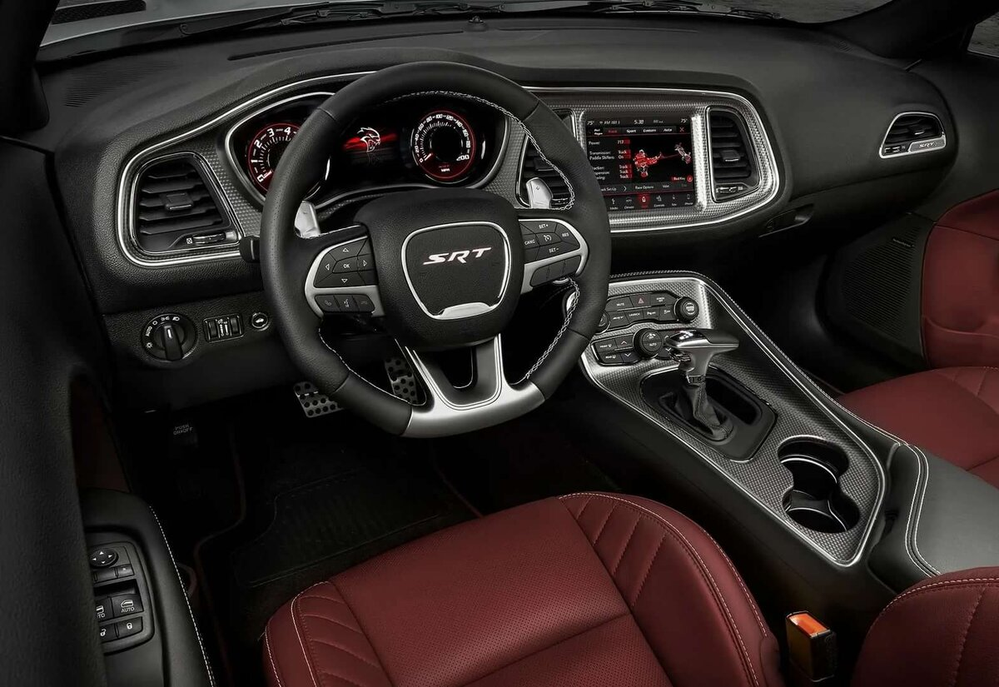
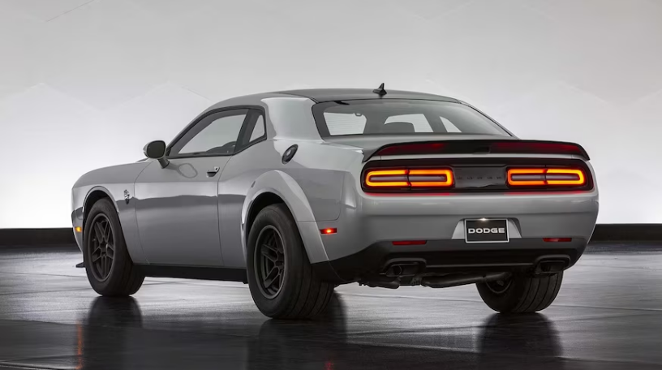
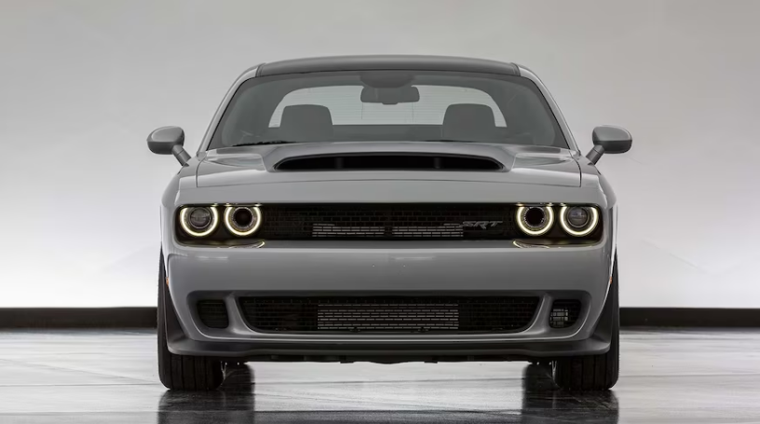
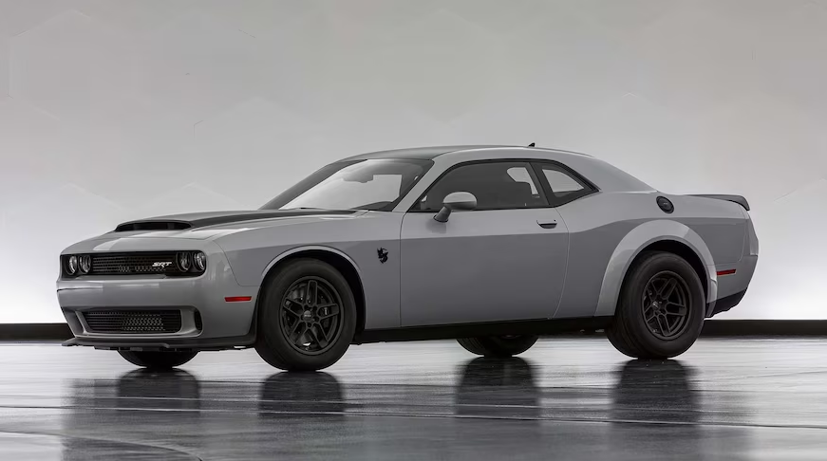

Slide 7
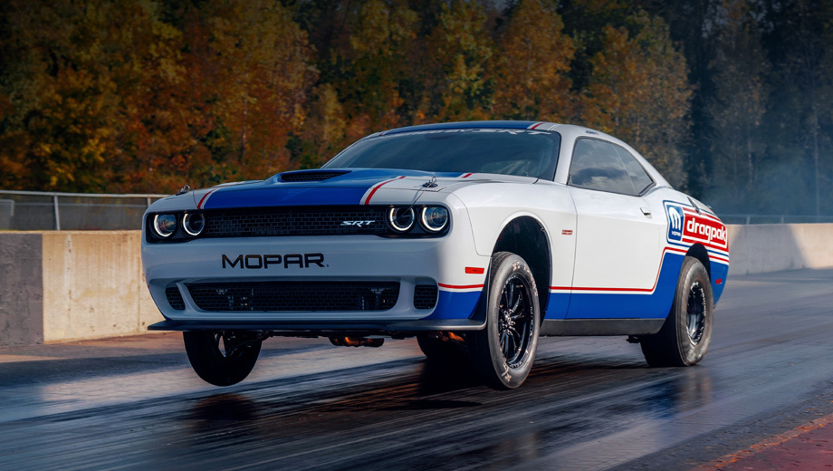
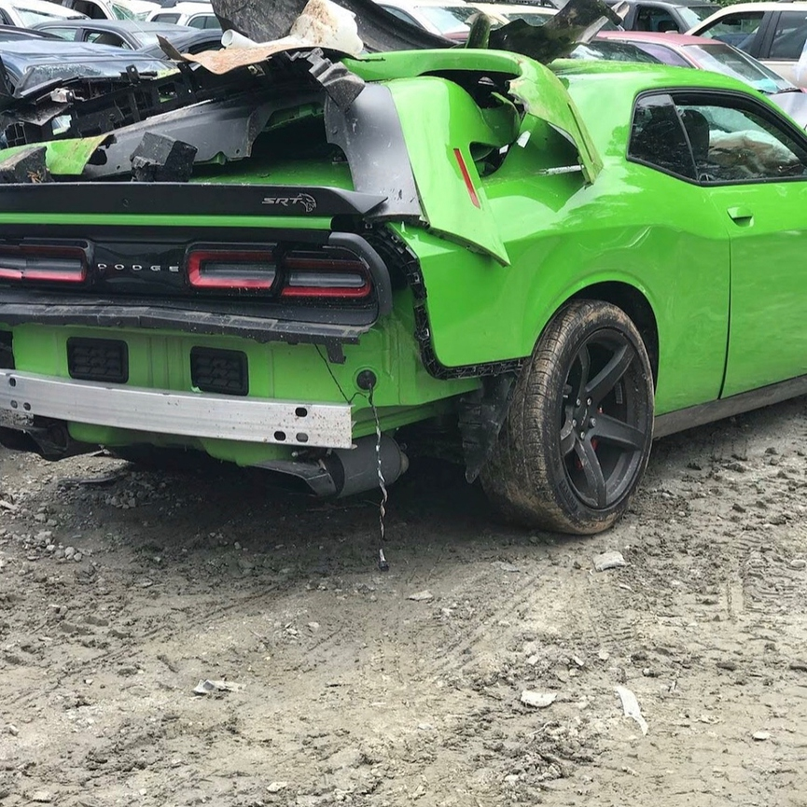
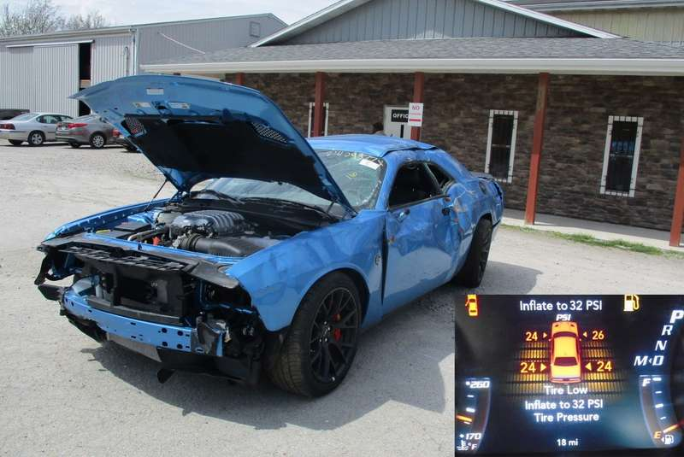
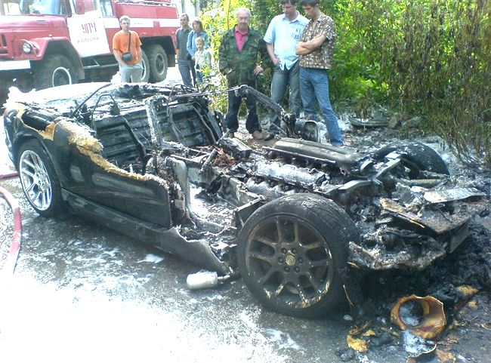

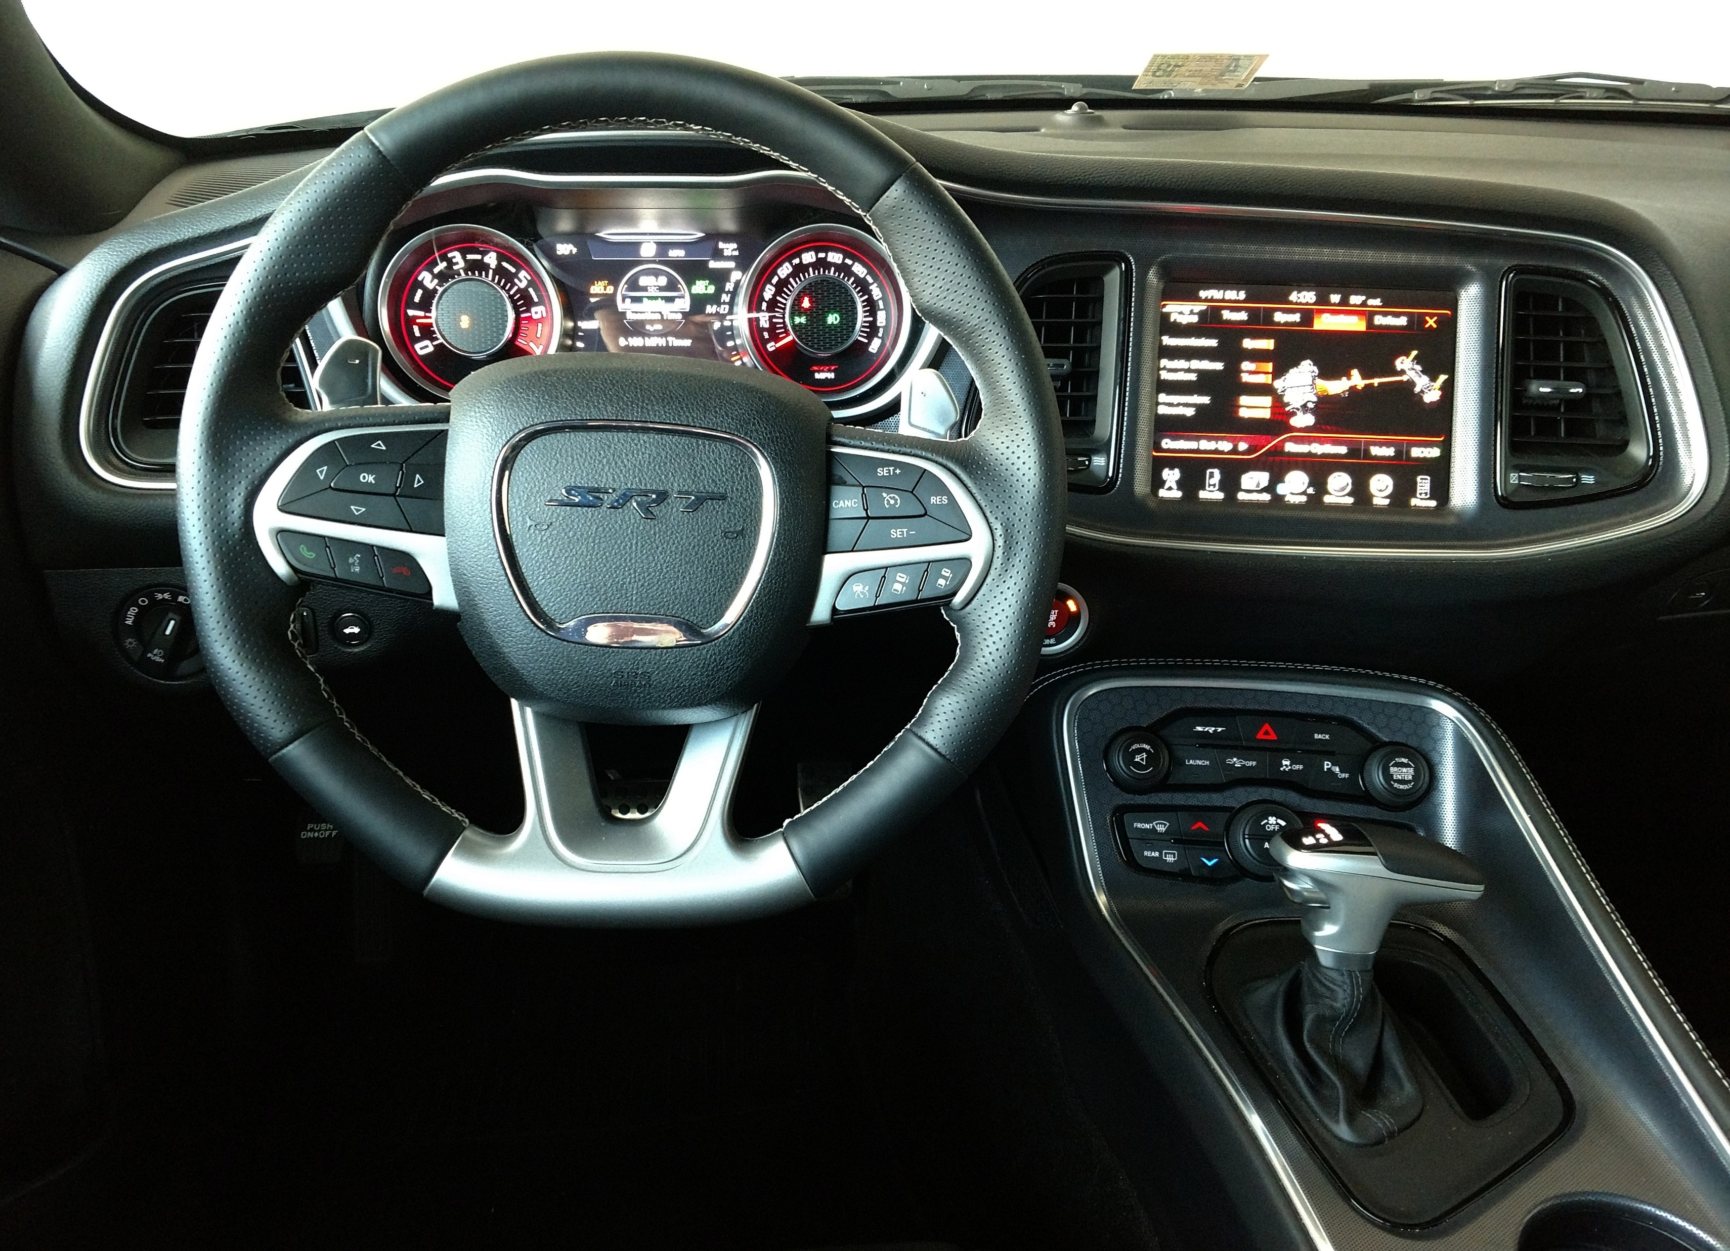




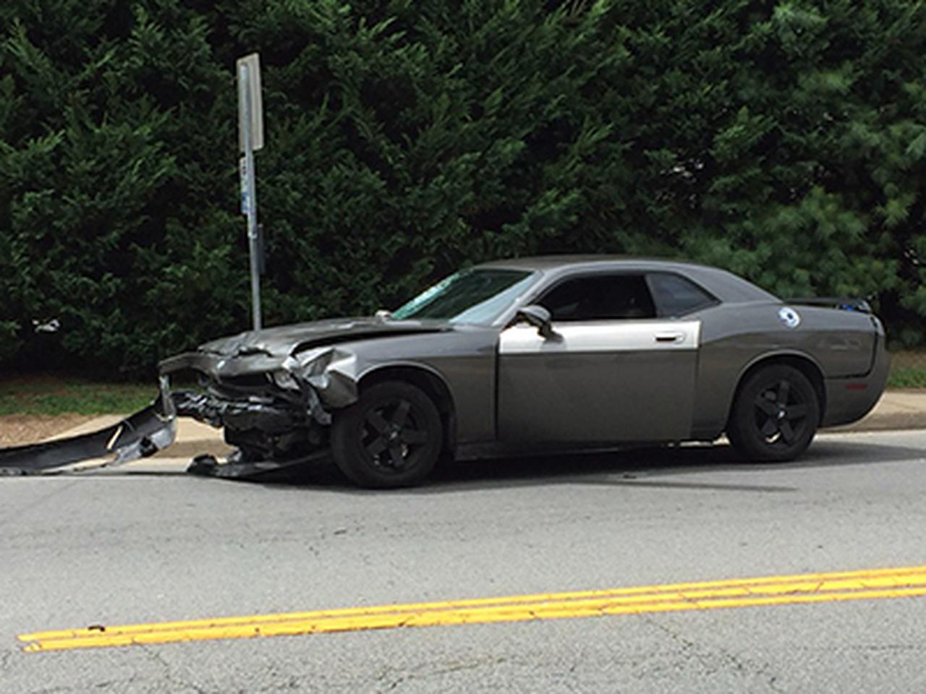
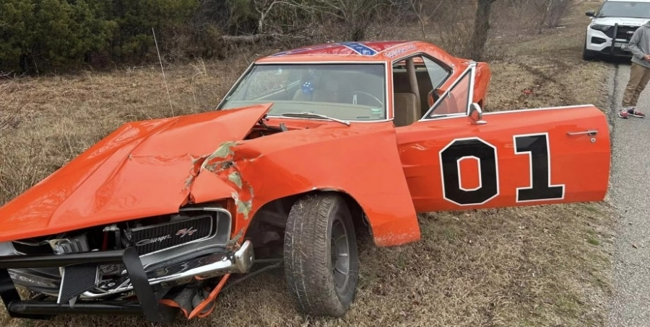

Slide 8
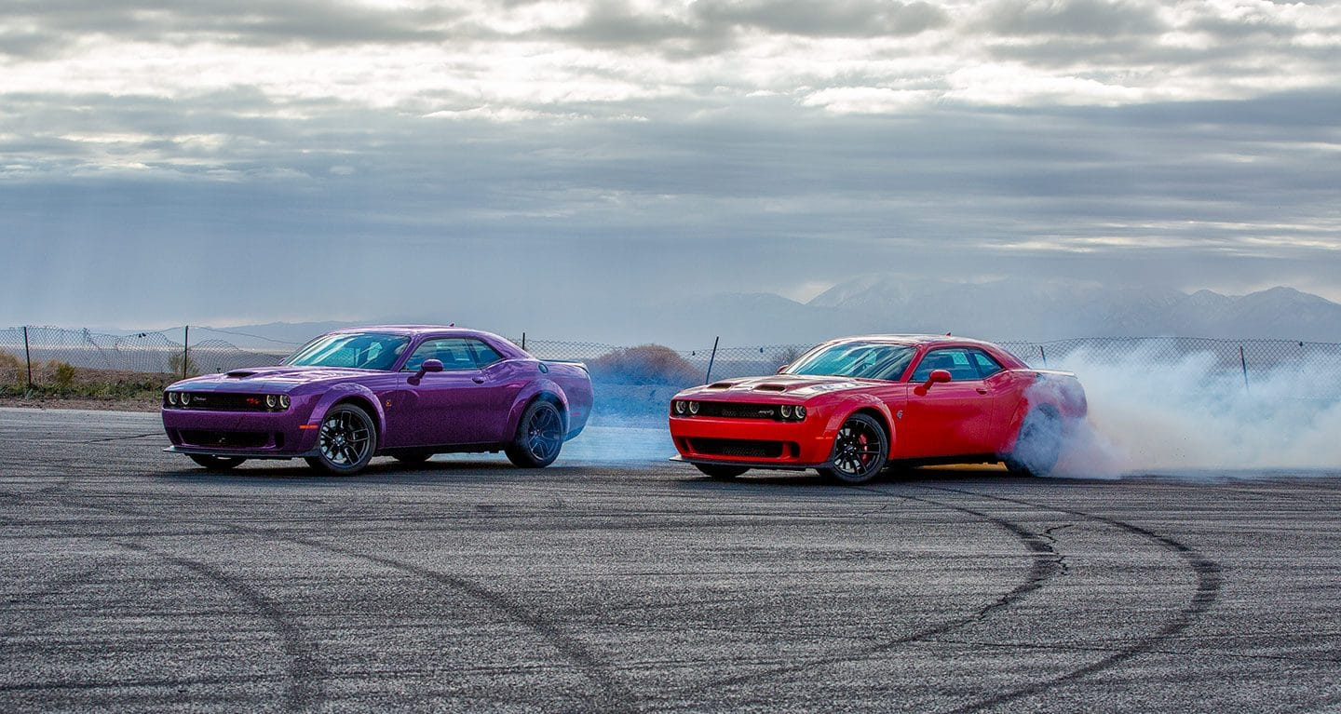
Suggestions for improving the Dodge Challenger
Model with safety cage as an optional extra;
Improved safety systems;
All-wheel drive as an additional feature in the safety system;
Increased versatility for traveling on more roads;
Special front axle weighting;
Use of higher quality materials in vehicle assembly;

Slide 9
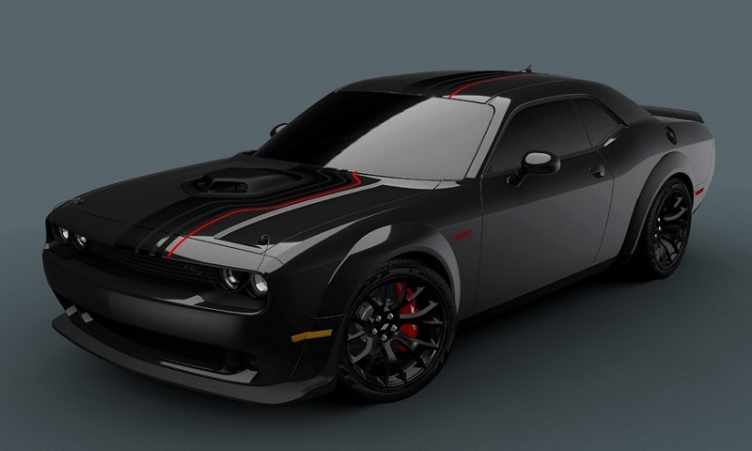
Conclusion
Within 100 thousand dollars the client gets a deadly beast with stunning appearance and sound and low-quality interior, which becomes a difficult task to curb.

Slide 10
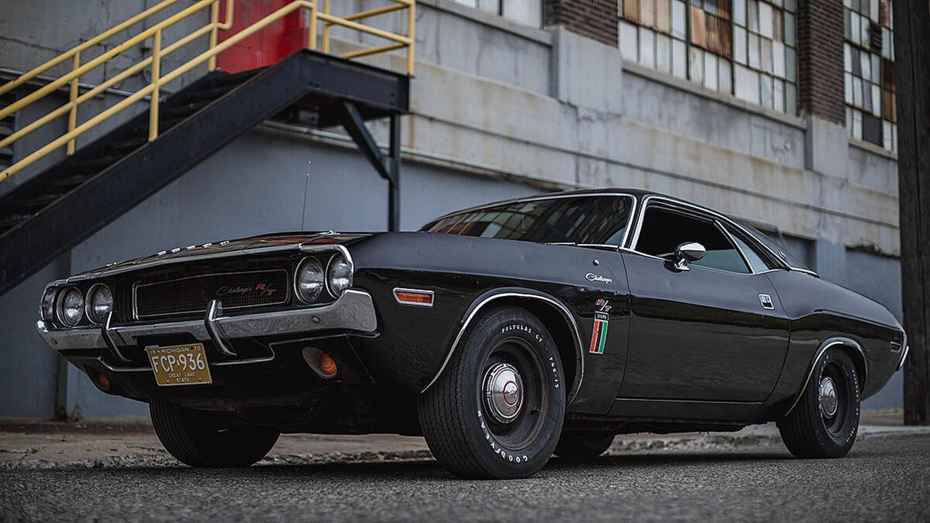
Thanks for your attention!

